Slide 1


HouseMonitor
OBYAT & Mansi

Slide 2
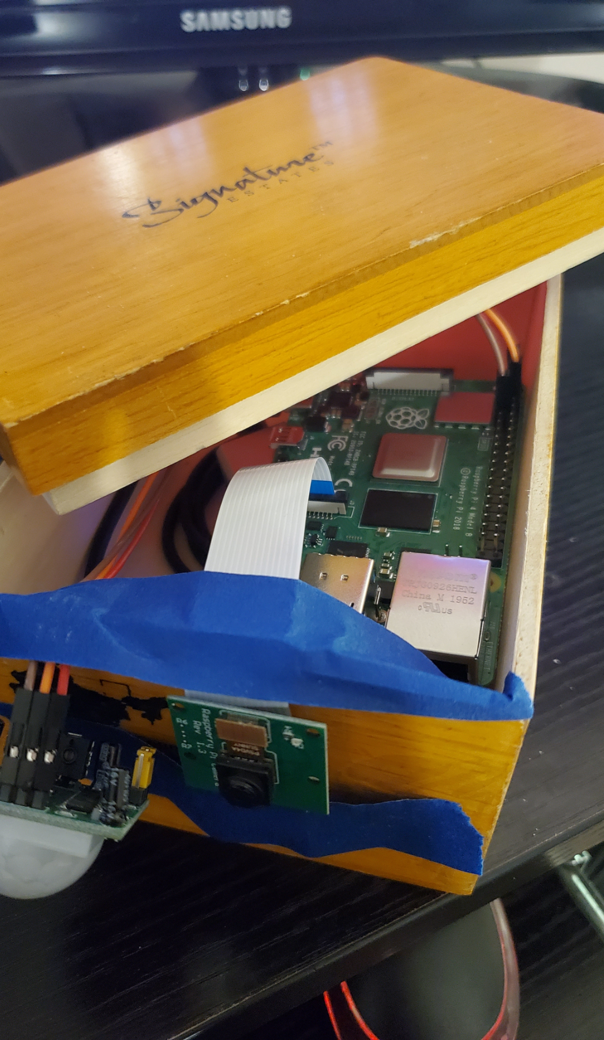
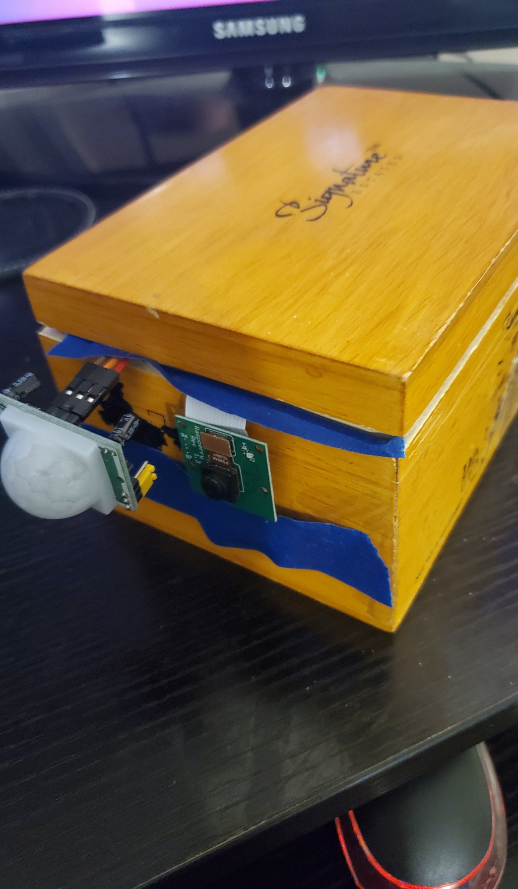
IOT
Always connected
Portable
Sensors
Auto-launch
Online Storage
Portable access

Slide 3
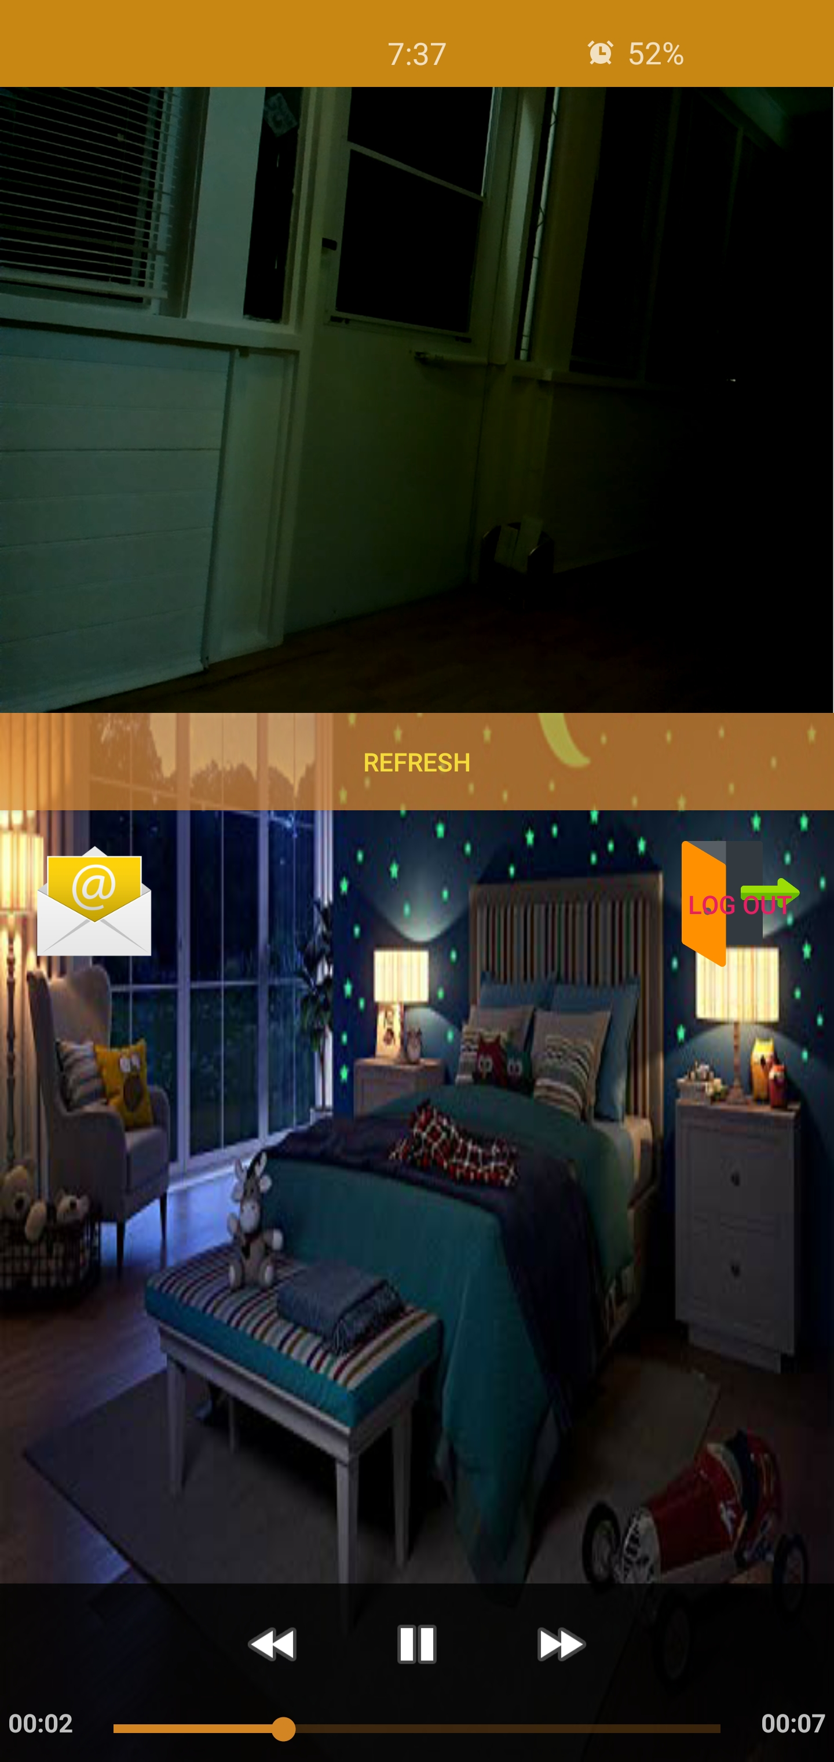
Use Cases
House Monitor
Baby monitor
Babysitter or dogsitter monitor
Anti-mail theft

Slide 4


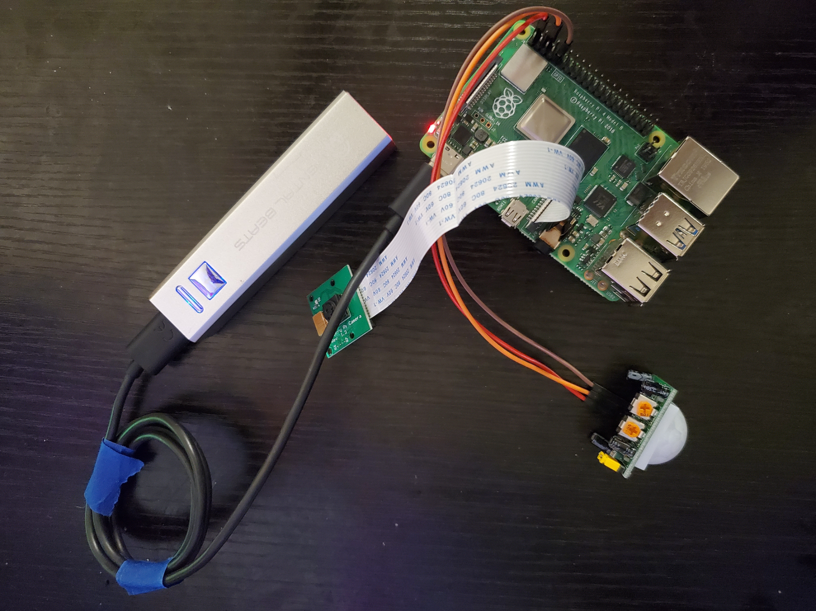



Hardware

Slide 5
Software
email
HouseMonitor.py
Auto-Launch
Driver Shortcut
Driver.sh
firebase.py
database
App

Slide 6

Driver Demo

Slide 7
HouseMonitor Demo

Slide 8

Phone App Demo
Reminder, download from Piazza!

Slide 9
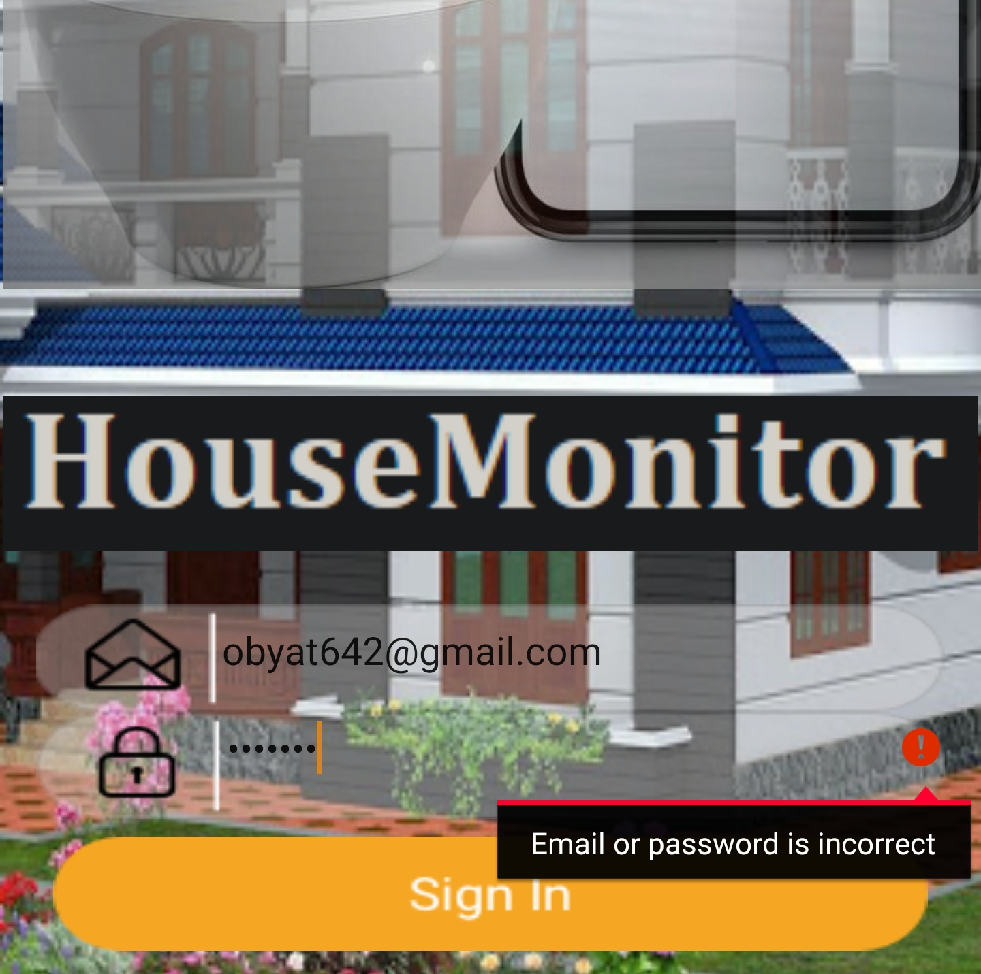
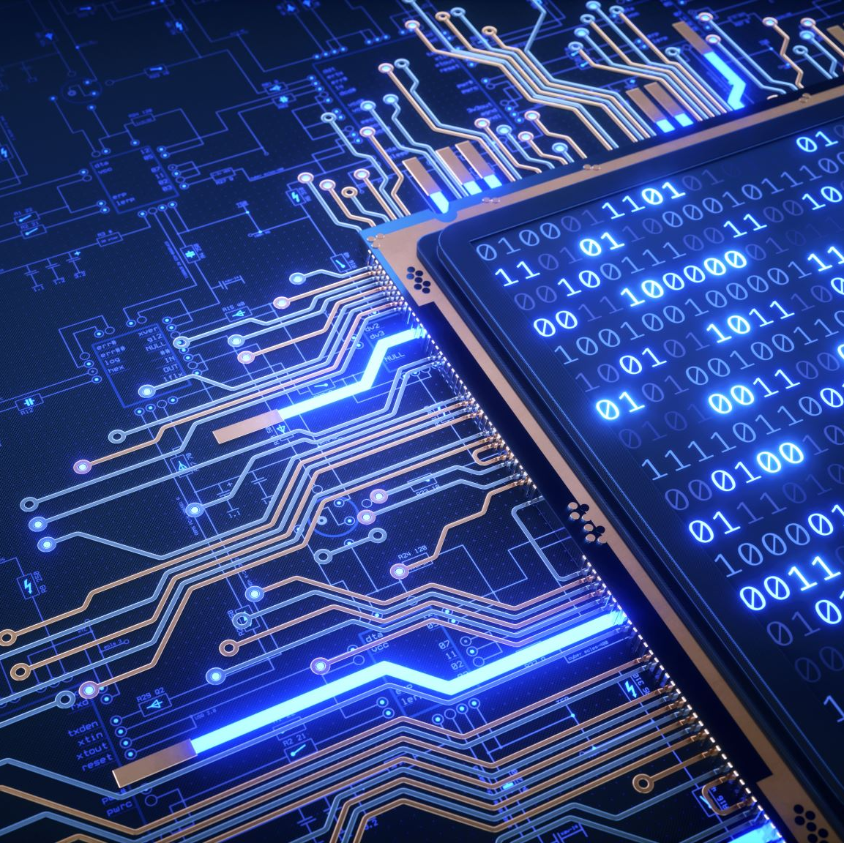
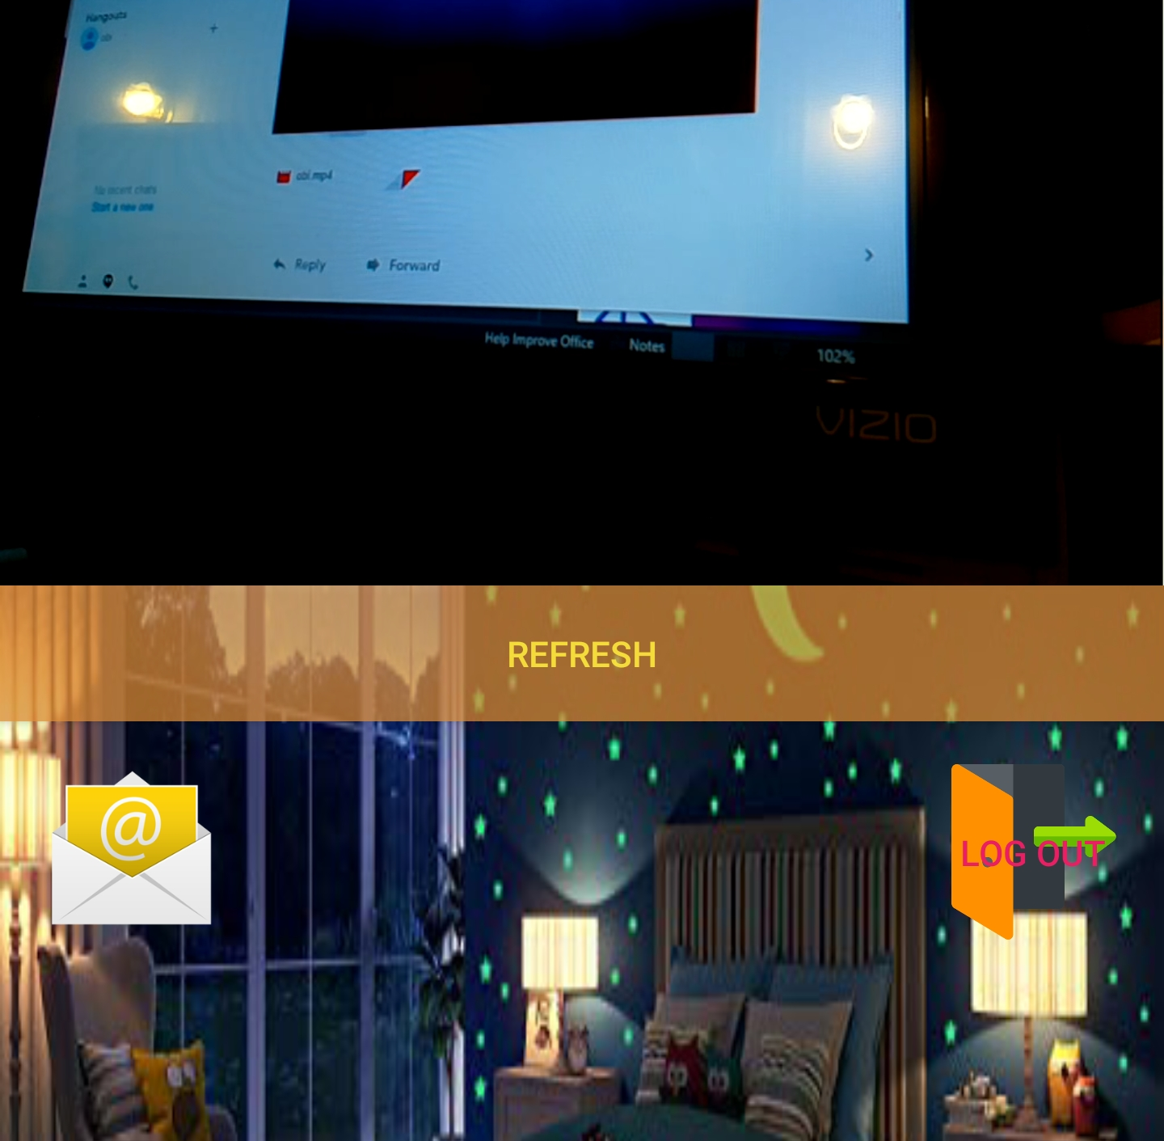
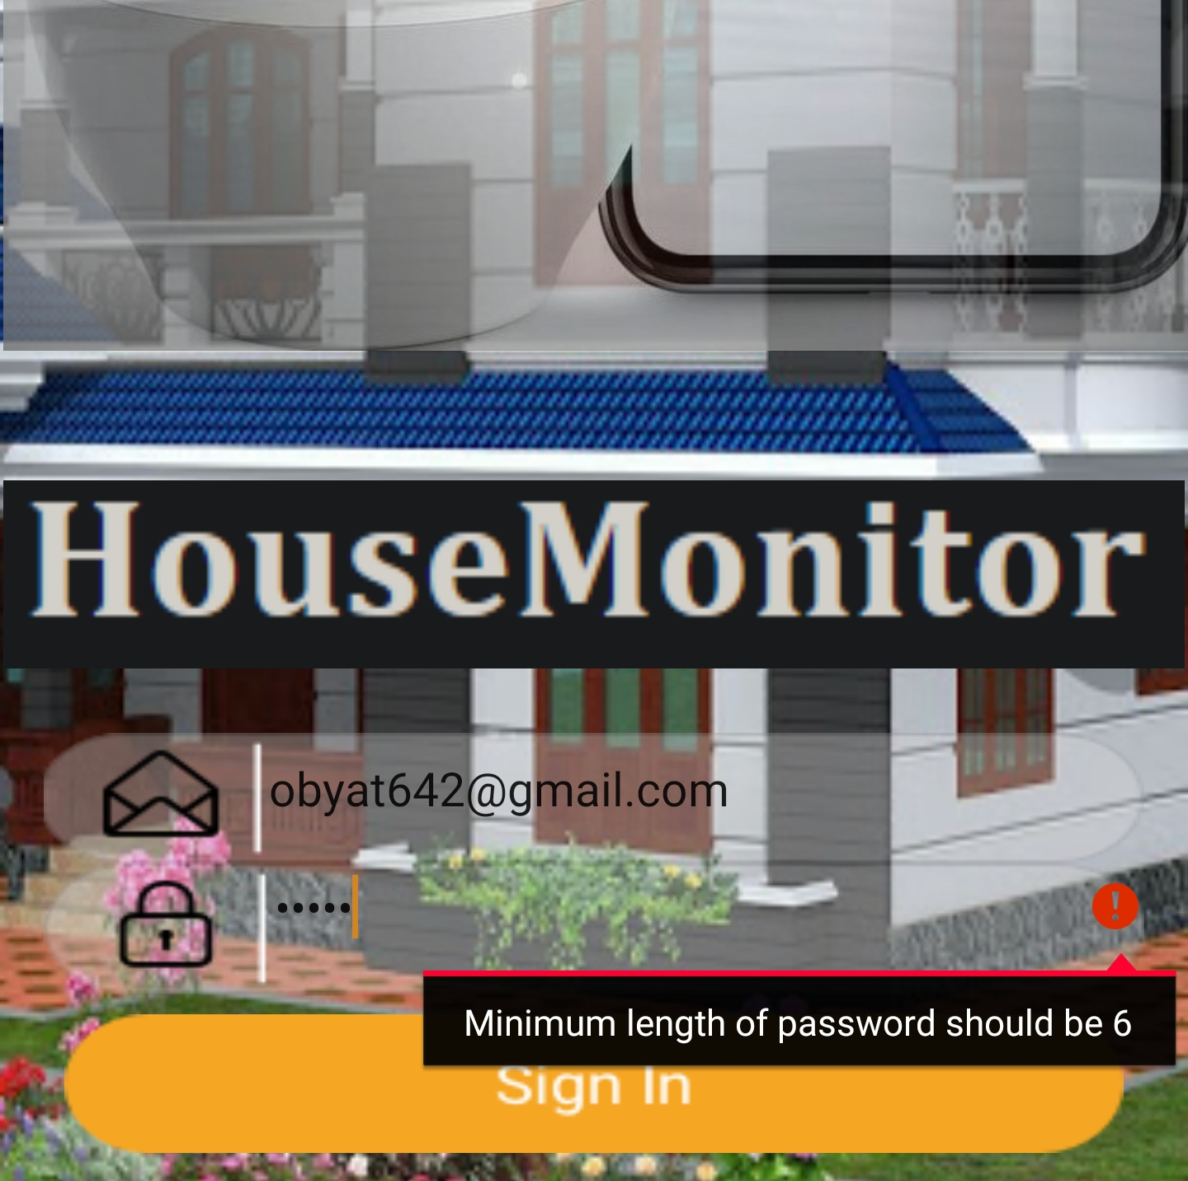
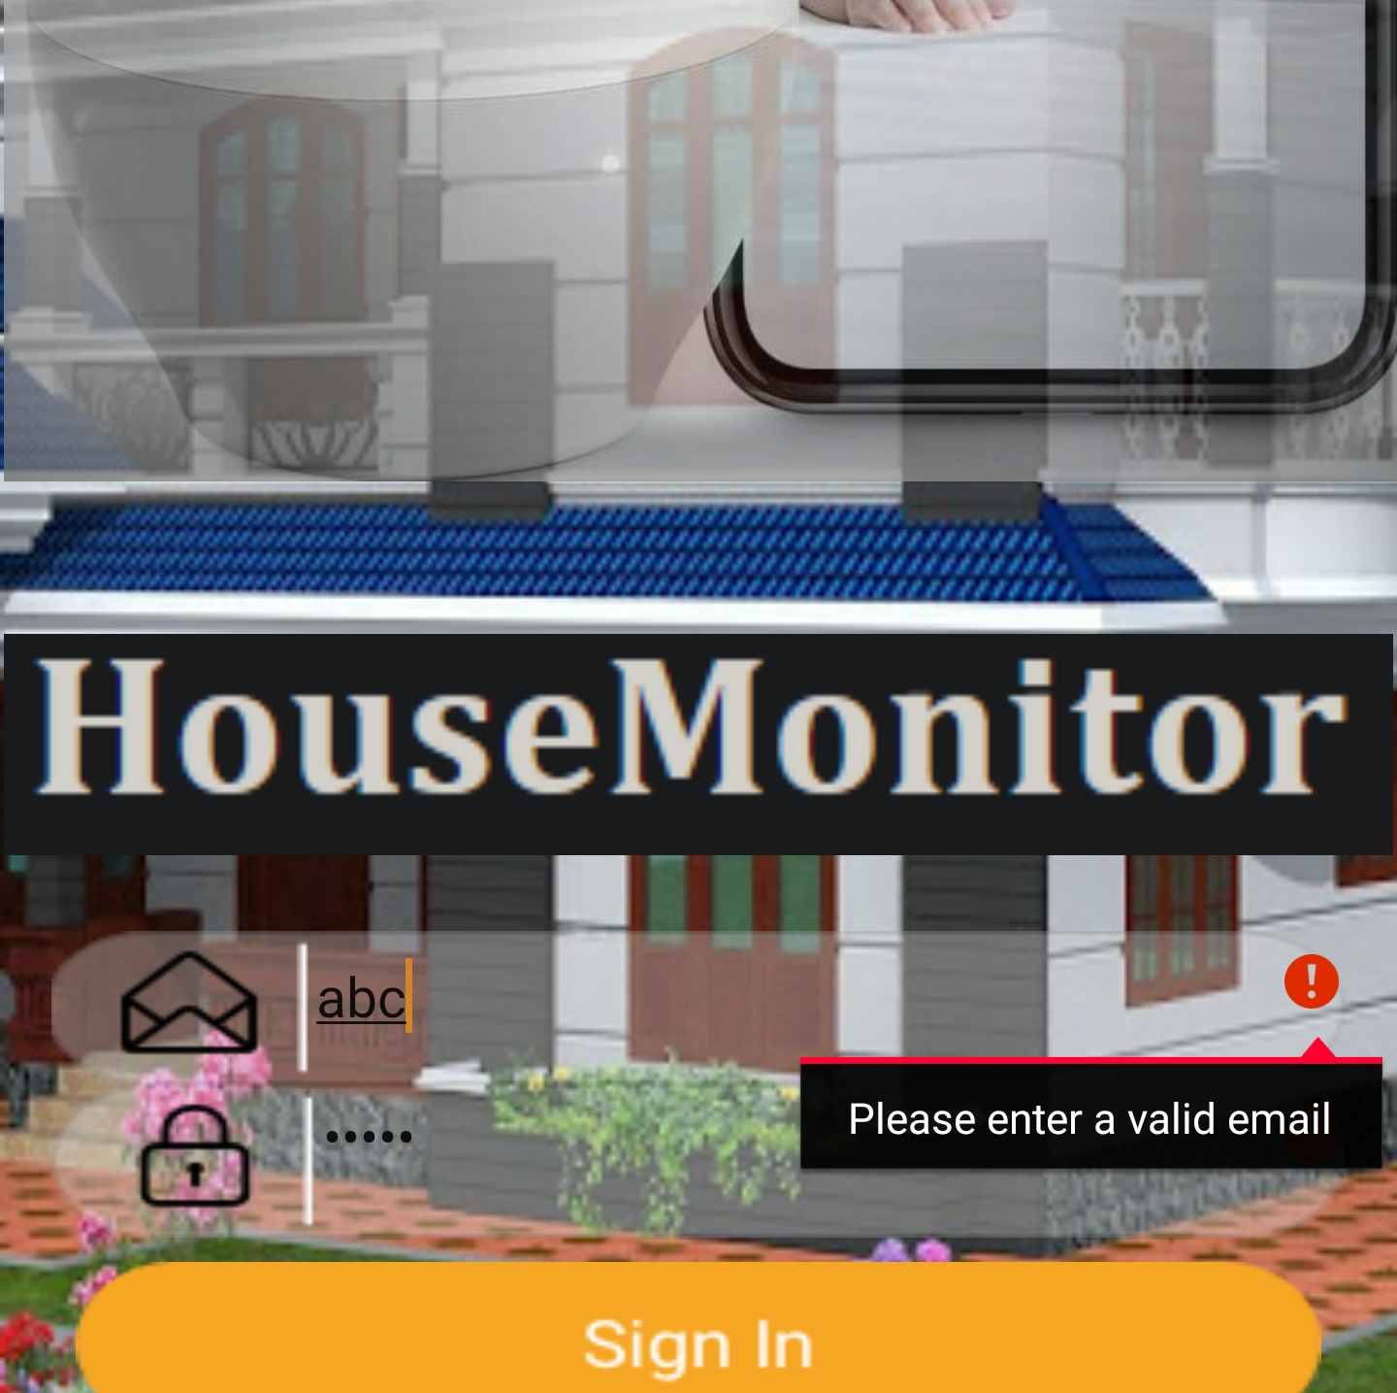

Security
Passwords stored locally, in Android and Pi
Valid email and passwords required through local syntax checking, entering less than 6 characters passwords gives an error on phone application
Only prompting email & passwords once, new users can't overwrite email and passwords
Relying on Gmail's email and passwords strength detection for HouseMonitor.py
Video uploaded and downloaded via Google's firebases which uses https
Last measure, if the RaspberryPi is stolen, then plugged in, email will be received via auto-launch and viewable on phone application

Slide 10

User-friendliness
Easy first time set up. Only register both app & device!
Auto-launch
Log off button with the app
Only burden with registration once
Easy launch any adjacent email app
Look & feel
Sacrificed continous authentication for immediate access!

Slide 11
HouseMonitor
Obyat & Mansi

